Slide 1
Huff Research Group Kendra Andersen
Group Meeting 12/4/17

Slide 2
Project Description
Navigation in Radio Frequency Landscapes using Autonomous Vehicles and Multiple Antenna Systems
Collect data on signal strength of various antenna systems using autonomous rovers.
Develop algorithm to plan a route for the rover which maximizes received signal strength (RSS).
Develop control strategy to examine signal strength at various frequencies for a GPS location and determine the best antenna configuration to maximize RSS.

Slide 3
Status
Last Week:
Coming up:
Set up time to gather data with Ryan.
Tested the algorithm using varying path lengths to determine its behavior.
Implemented prioritization of either minimum path length or maximum signal strength.
Automate graph creation and test algorithm with Sarah’s data.
Update the path-planning algorithm to use real data and to determine optimal paths in real-time.
Assist Ryan in collecting data.

Slide 4
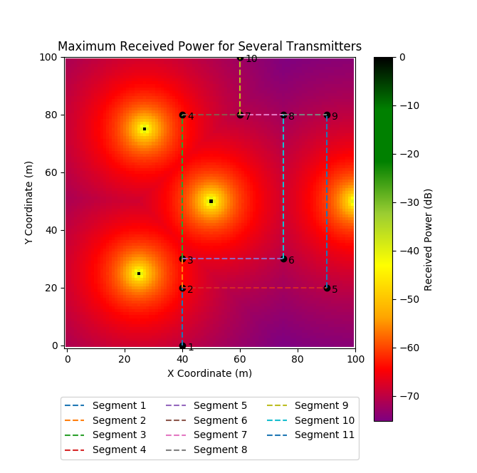
Findings/Progress Applying Dijkstra’s to different path lengths
EXAMPLE 1
(strongly minimizing path length)
Sample Output:
Path from Node 1 to Node 10 maximizing transmitter at [25,25]:
Path: [1, 2, 3, 4, 7, 10]
Cost: 8555.70736208
Path from Node 1 to Node 10 maximizing transmitter at [100,50]:
Path: [1, 2, 3, 4, 7, 10]
Cost: 9132.26631349

Slide 5
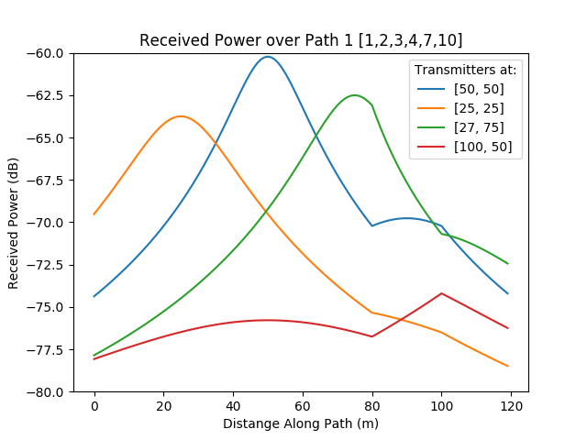
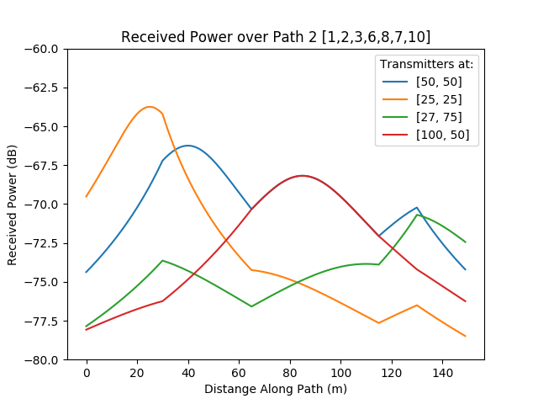
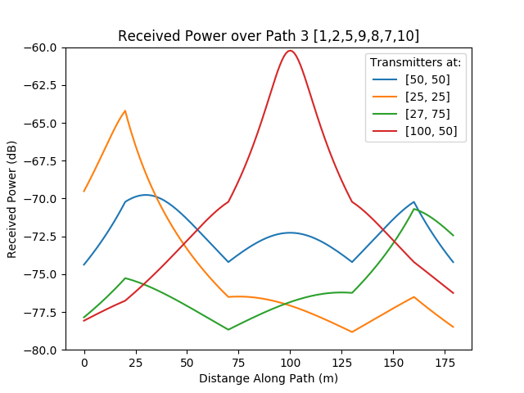

Slide 6
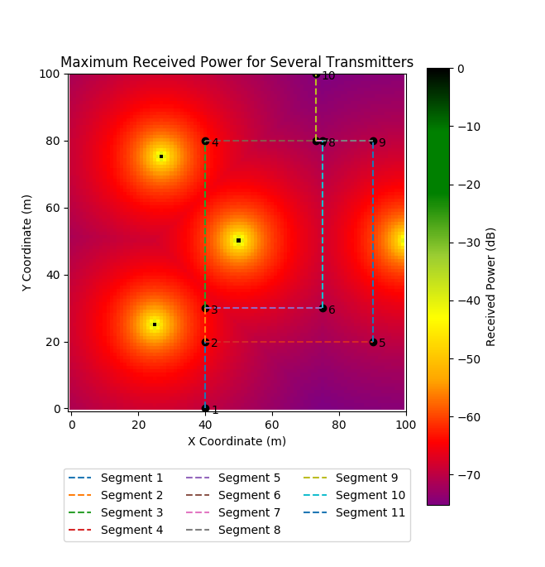
Findings/Progress Applying Dijkstra’s to different path lengths
EXAMPLE 2
(strongly minimizing path length)
Sample Output:
Path from Node 1 to Node 10 maximizing transmitter at [25,25]:
Path: [1, 2, 3, 4, 7, 10]
Cost: 9572.15270099
Path from Node 1 to Node 10 maximizing transmitter at [100,50]:
Path: [1, 2, 3, 6, 8, 7, 10]
Cost: 9980.96246694

Slide 7
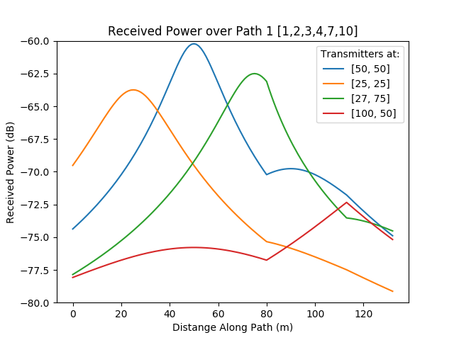
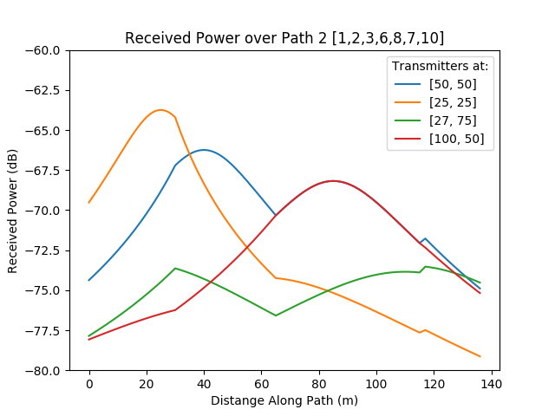
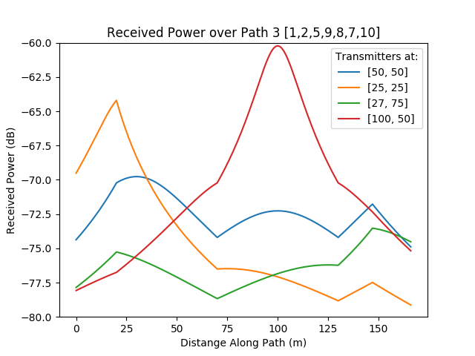

Slide 8
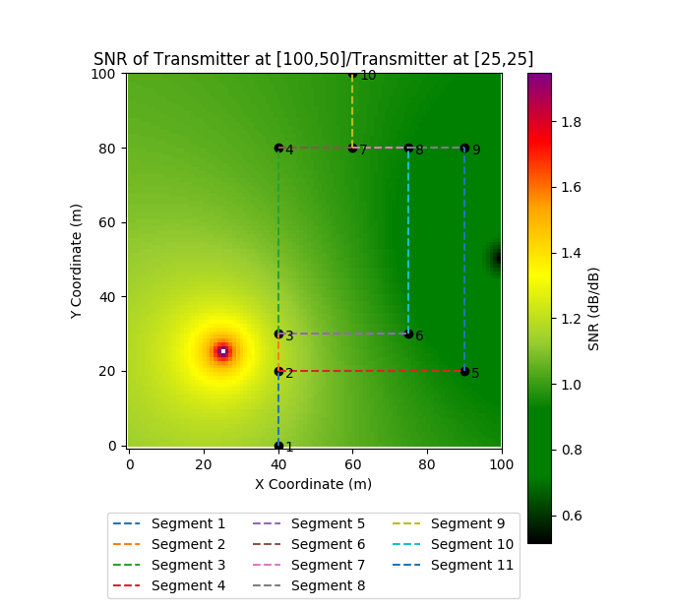
Findings/Progress Applying Dijkstra’s to different path lengths
EXAMPLE 3
(strongly minimizing path length)
Sample Output:
Path from Node 1 to Node 10 maximizing SNR of [100,50]/[25,25]:
Path: [1, 2, 3, 4, 7, 10]
Cost: 128.736491442
(Path 1)

Slide 9
Example 3 To avoid a transmitter, will a longer path be taken?
X Coordinate of Segment 9 | Path Selected | Path Selected | Path 1 Length | Path 2 Length | Cost
60 | [1, 2, 3, 4, 7, 10] | Path 1 | 120 | 150 | 128.736491442
70 | [1, 2, 3, 4, 7, 10] | Path 1 | 130 | 140 | 137.876685673
71 | [1, 2, 3, 4, 7, 10] | Path 1 | 131 | 139 | 138.775588298
72 | [1, 2, 3, 6, 8, 7, 10] | Path 2 | 132 | 138 | 139.601944877
74 | [1, 2, 3, 6, 8, 7, 10] | Path 2 | 134 | 136 | 137.647008887

Slide 10
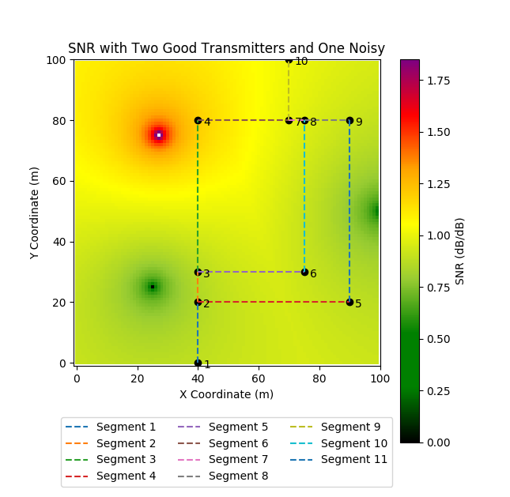
Findings/Progress Applying Dijkstra’s to different path lengths
EXAMPLE 4
(strongly minimizing path length)
Sample Output:
Path form Node 1 to Node 10 maximizing SNR with two good and one noisy:
Path: [1, 2, 3, 6, 8, 7, 10]
Cost: 129.992444988
(Path 2)

Slide 11
Example 4 To avoid a transmitter, will a longer path be taken?
X Coordinate of Segment 9 | Path Selected | Path Selected | Path 1 Length | Path 2 Length | Cost
60 | [1, 2, 3, 4, 7, 10] | Path 1 | 120 | 150 | 121.617311548
65 | [1, 2, 3, 4, 7, 10] | Path 1 | 125 | 145 | 126.354322499
69 | [1, 2, 3, 4, 7, 10] | Path 1 | 129 | 141 | 130.078962373
70 | [1, 2, 3, 6, 8, 7, 10] | Path 2 | 130 | 140 | 129.992444988
71 | [1, 2, 3, 6, 8, 7, 10] | Path 2 | 131 | 139 | 128.916728367
74 | [1, 2, 3, 6, 8, 7, 10] | Path 2 | 134 | 136 | 125.726247116

Slide 12
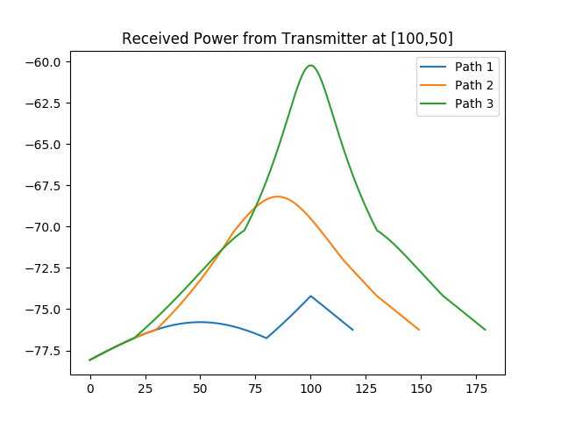
Findings/Progress Applying Dijkstra’s to different path lengths with prioritization
EXAMPLE 5
(strongly maximizing signal strength)
Sample Output:
Path from Node 1 to Node 10 strongly maximizing transmitter at [100,50]:
Path: [1, 2, 3, 6, 8, 7, 10]
Cost: 1.73409321277e+15
(Path 2)

Slide 13
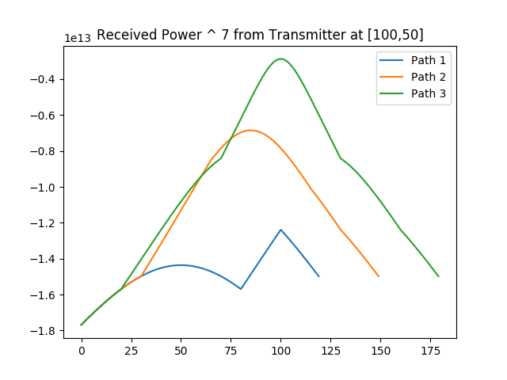
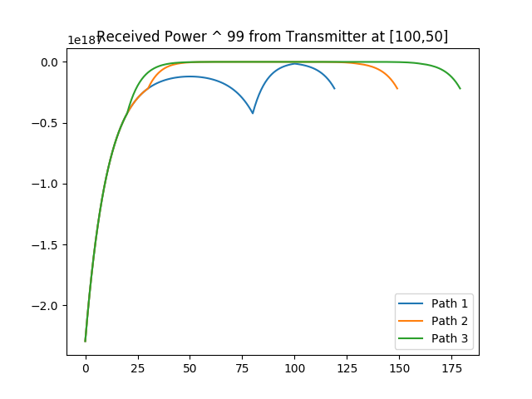
Applying Dijkstra’s with prioritization

